Slide 1
Spectral Clustering
Presented by: Yosser Fhal

Slide 2
What is Clustering?
Clustering means grouping similar data points.
Traditional clustering (like K-Means) uses distance between points.
But what if “closeness” isn’t just about distance; it’s about relationships?
Example:
In a social network, two people might not be directly connected, but they may still belong to the same friend group through shared connections!
→ That’s when Spectral Clustering helps.

Slide 3
What is Spectral Clustering?
Spectral clustering looks at how points are connected instead of just how far apart they are.
It does this by:
  Turning the data into a graph, points become nodes, and connections between them become edges.
  Studying that graph using math tools called eigenvalues and eigenvectors.
  Finding natural groups or “communities” within the graph.
Think of it like finding communities of friends in a big social network!

Slide 4
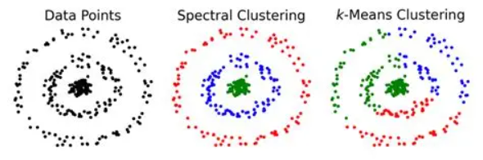
Why is Spectral Clustering powerful?
Works with irregular or non-spherical shapes.
Can find complex, non-linear patterns.
Excellent for graph-based data (like social networks or web pages)
Doesn’t depend only on geometric distance.

Slide 5
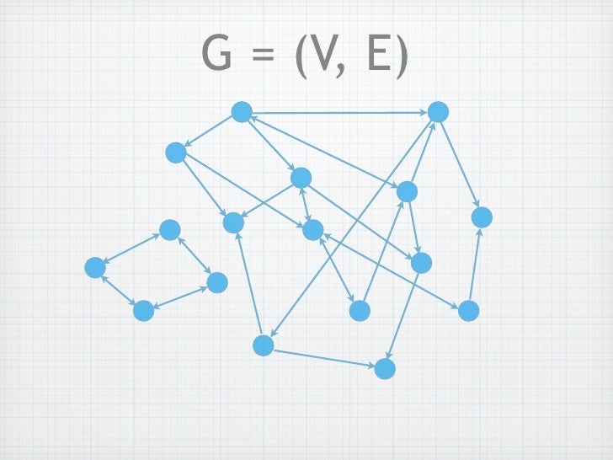
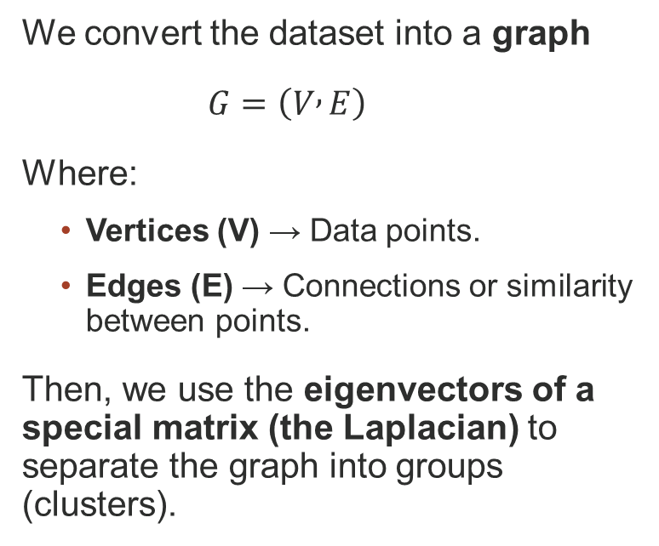
Representing Data as a Graph
We convert the dataset into a graph
$G=\left(V , E\right)$
Where:
  Vertices (V) → Data points.
  Edges (E) → Connections or similarity between points.
Then, we use the eigenvectors of a special matrix (the Laplacian) to separate the graph into groups (clusters).

Slide 6
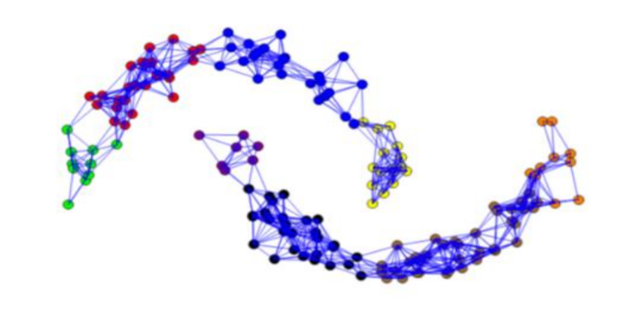
Building the Similarity Graph (1/3)
There are three main ways to connect nodes:
ε-neighborhood graph
  Connect points if distance < ε
  → Simple, but sensitive to ε value

Slide 7
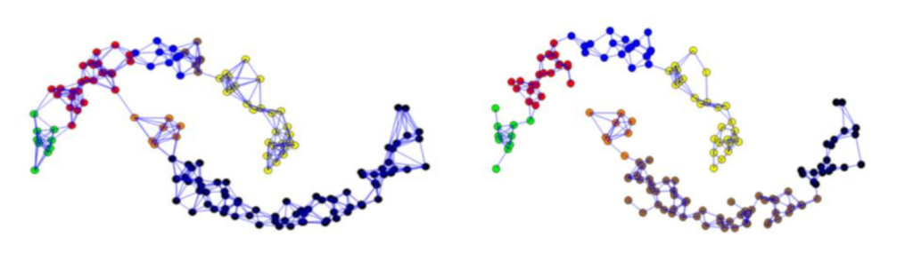
Representing Data as a Graph (2/3)
k-nearest neighbours (k-NN) graph
  Each point connects to its k closest neighbours.
  → Captures local structure

Slide 8
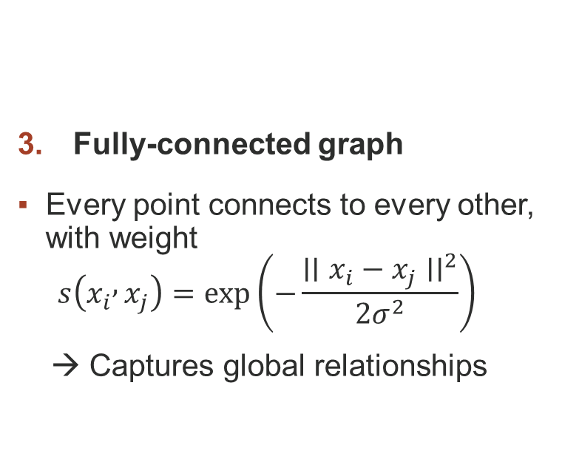
Representing Data as a Graph (3/3)
Fully-connected graph
Every point connects to every other, with weight
  $$s\left(x_{i} , x_{j}\right)=\exp\left(−\frac{∣∣x_{i}−x_{j}∣∣^{2}}{2σ^{2}}\right)$$
  → Captures global relationships

Slide 9
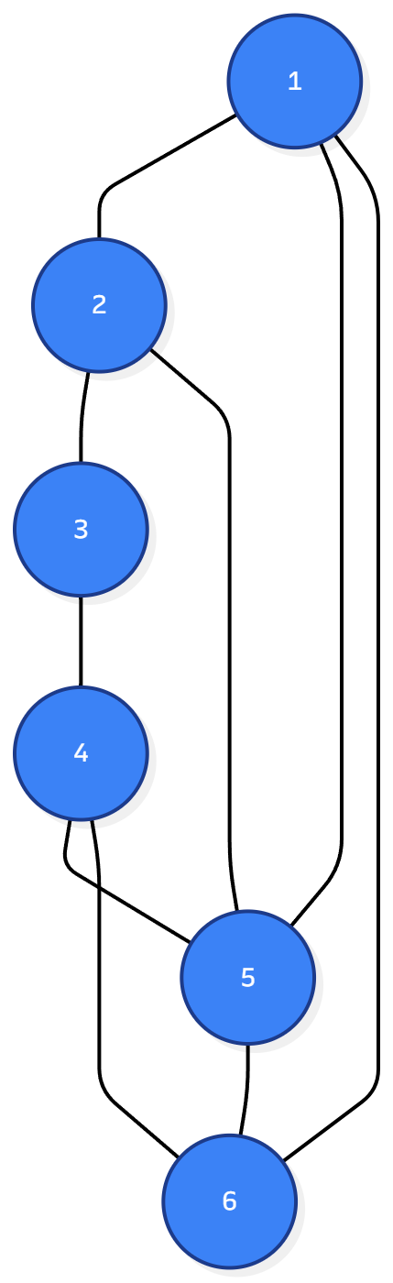
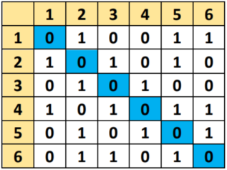
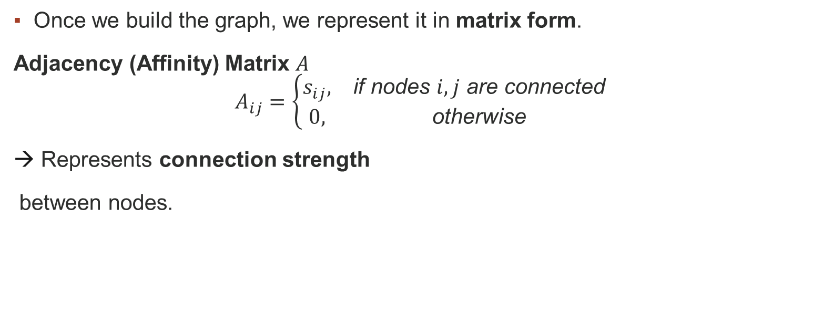
Matrices in Spectral Clustering (1/3)
Once we build the graph, we represent it in matrix form.
Adjacency (Affinity) Matrix $A$
$$A_{ij}=\left\{\begin{matrix}s_{ij}, & \text{if} \text{nodes} i,j \text{are} \text{connected} \\ 0, & \text{otherwise}\end{matrix}\right.$$
Represents connection strength
between nodes.

Slide 10
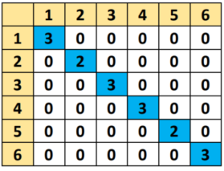

Matrices in Spectral Clustering (2/3)
Degree Matrix $D$
Diagonal matrix with: $D_{ii}=\sum_{j}{A_{ij}}$
Represents the strength of the connections of each node .

Slide 11
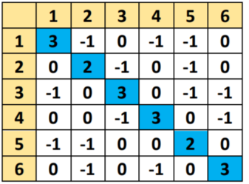

Matrices in Spectral Clustering (3/3)
Laplacian Matrix $L$
Core of spectral clustering: $L=D−A$
→ It measures how much each node differs from its neighbours.

Slide 12
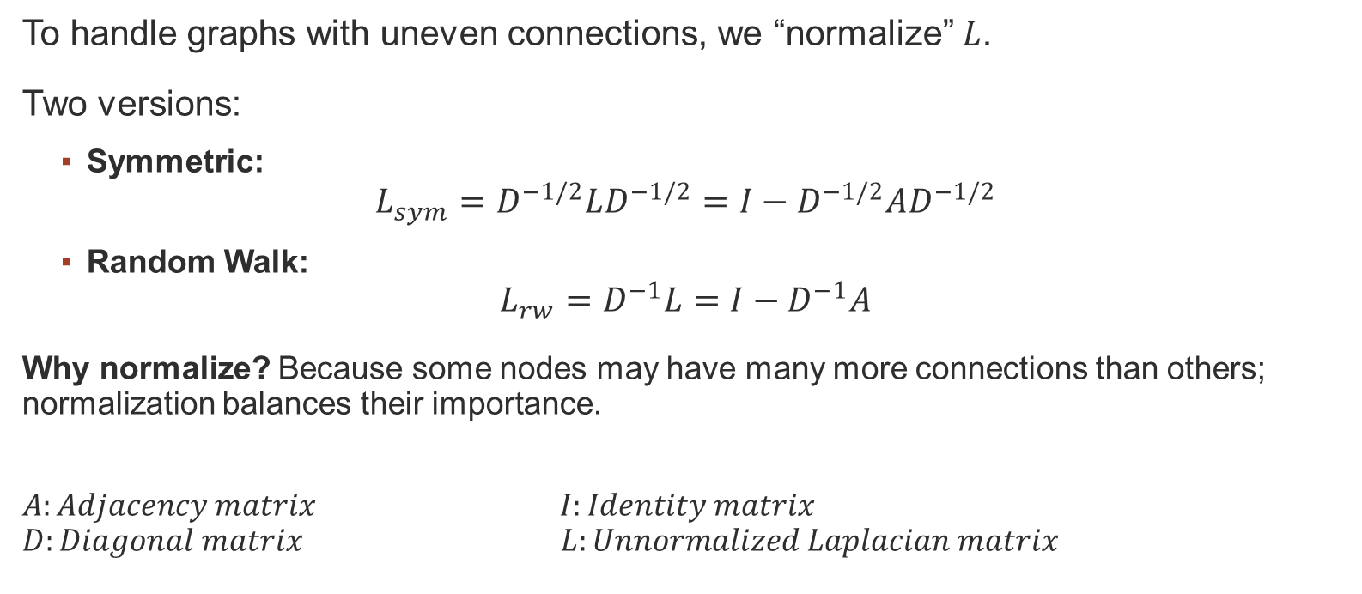
Normalized Laplacians
To handle graphs with uneven connections, we “normalize” $L$.
Two versions:
  Symmetric:
$$L_{sym}=D^{−1/2}LD^{−1/2}=I−D^{−1/2}AD^{−1/2}$$
  Random Walk:
$$L_{rw}=D^{−1}L=I−D^{−1}A$$
Why normalize? Because some nodes may have many more connections than others; normalization balances their importance.
$$A:Adjacency matrix I:Identity matrix$$
$$D:Diagonal matrix L:Unnormalized Laplacian matrix$$

Slide 13
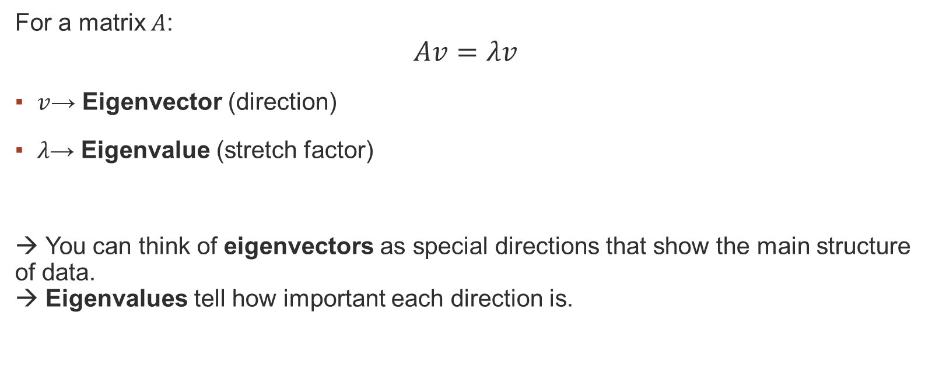
Eigenvalues and Eigenvectors (1/2)
For a matrix $A$:
$$Av=λv$$
$v$→ Eigenvector (direction)
$λ$→ Eigenvalue (stretch factor)
→ You can think of eigenvectors as special directions that show the main structure of data.
→ Eigenvalues tell how important each direction is.

Slide 14
Eigenvalues and Eigenvectors (2/2)
In spectral clustering:
Small eigenvalues show the smoothest ways to divide the graph.
The second smallest eigenvalue (called the Fiedler value) helps find the best split.
The Fiedler vector tells how to divide the data into two groups.
→ If you see a big gap between eigenvalues, it usually means that clear clusters exist.

Slide 15
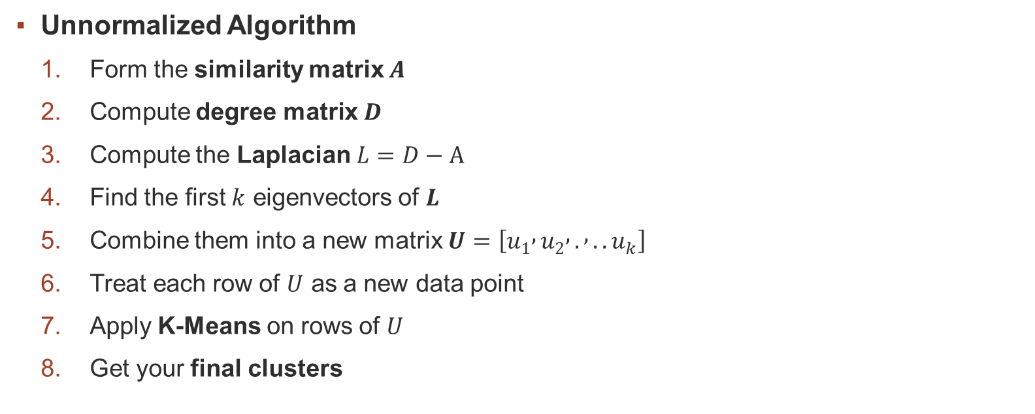
Spectral Clustering Algorithm
Unnormalized Algorithm
  Form the similarity matrix $A$
  Compute degree matrix $D$
  Compute the Laplacian $L=D−A$
  Find the first $k$ eigenvectors of $L$
  Combine them into a new matrix $U=\left[u_{1} , u_{2} , . , ..u_{k}\right]$
  Treat each row of $U$ as a new data point
  Apply K-Means on rows of $U$
  Get your final clusters

Slide 16
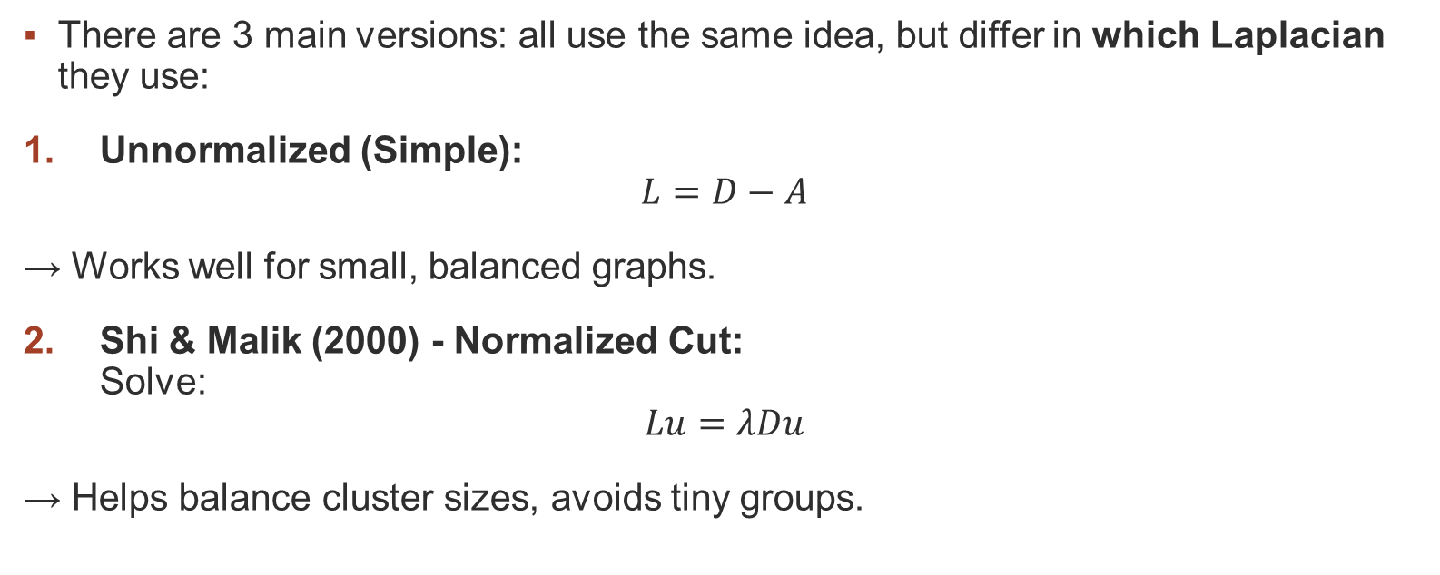
Algorithm Variants (1/2)
There are 3 main versions: all use the same idea, but differ in which Laplacian they use:
Unnormalized (Simple):
$$L=D−A$$
→ Works well for small, balanced graphs.
Shi & Malik (2000) - Normalized Cut:
Solve:
$$Lu=λDu$$
→ Helps balance cluster sizes, avoids tiny groups.

Slide 17
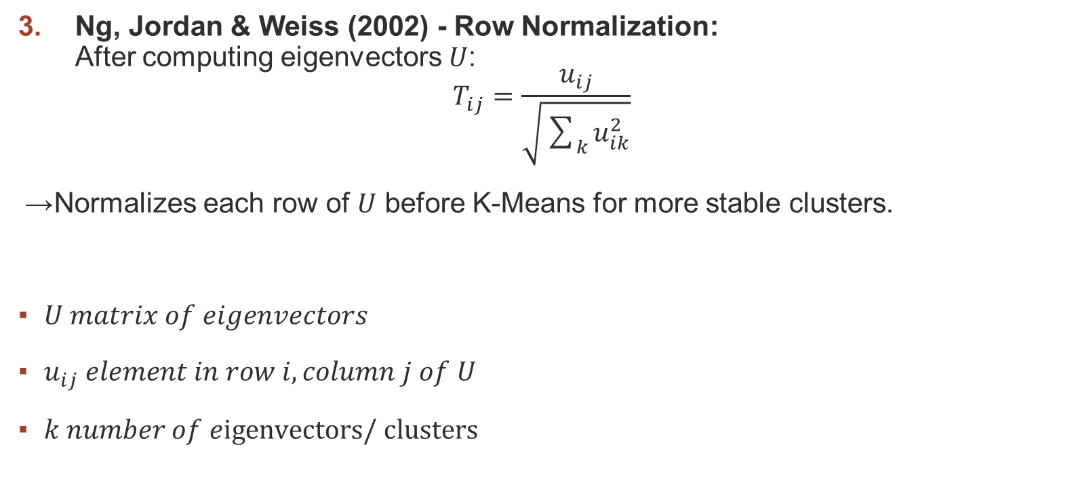
Algorithm Variants (2/2)
Ng, Jordan & Weiss (2002) - Row Normalization:
After computing eigenvectors $U$:
$$T_{ij}=\frac{u_{ij}}{\sqrt{\sum_{k}{u_{ik}^{2}}}}$$
→ Normalizes each row of $U$ before K-Means for more stable clusters.
$U matrix of eigenvectors$
$u_{ij} element in row i, column j of U$
$k number of e\text{igenvectors}\text{/ }\text{clusters}$

Slide 18
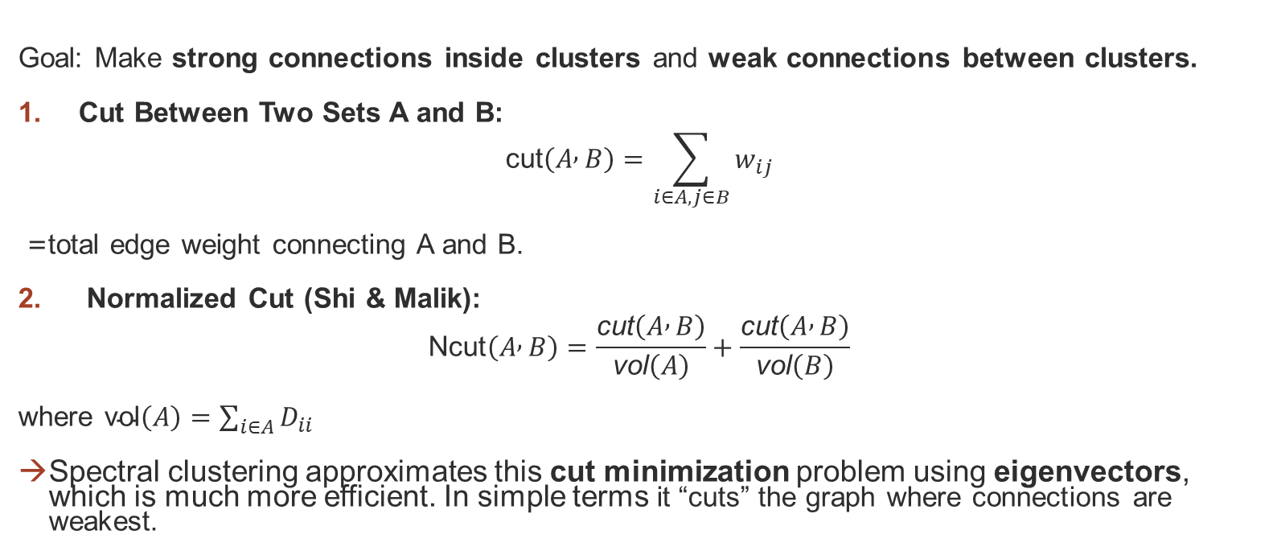
Graph Cuts
Goal: Make strong connections inside clusters and weak connections between clusters.
Cut Between Two Sets A and B:
$$\text{cut}\left(A , B\right)=\sum_{i∈A,j∈B}{w_{ij}}$$
= total edge weight connecting A and B.
Normalized Cut (Shi & Malik):
$$\text{Ncut}\left(A , B\right)=\frac{\text{cut}\left(A , B\right)}{\text{vol}\left(A\right)}+\frac{\text{cut}\left(A , B\right)}{\text{vol}\left(B\right)}$$
where $\text{vol}\left(A\right)=\sum_{i∈A}{D_{ii}}$
Spectral clustering approximates this cut minimization problem using eigenvectors, which is much more efficient. In simple terms it “cuts” the graph where connections are weakest.

Slide 19
The Graph Cutting Idea
The goal is to cut the graph into groups so:
  Connections inside each group are strong.
  Connections between groups are weak.
Spectral clustering finds where to “cut” the graph using eigenvectors instead of trying every possible cut (which would be too slow).

Slide 20
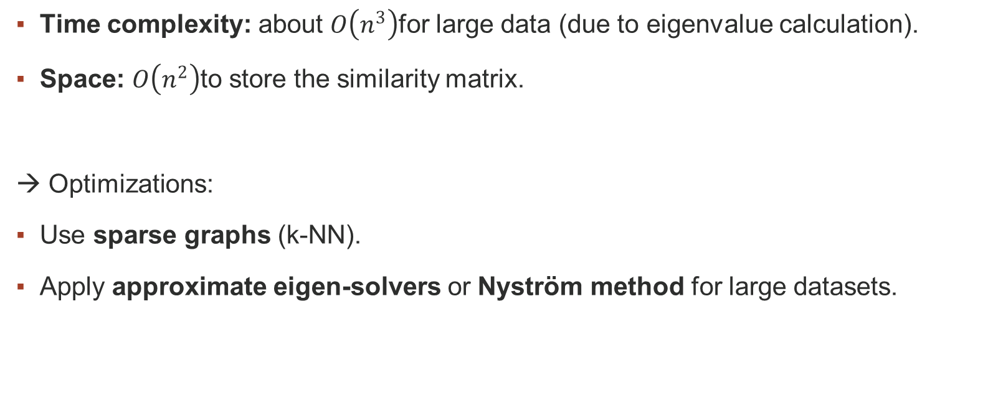
Complexity and Limitations
Time complexity: about $O\left(n^{3}\right)$for large data (due to eigenvalue calculation).
Space: $O\left(n^{2}\right)$to store the similarity matrix.
→ Optimizations:
Use sparse graphs (k-NN).
Apply approximate eigen-solvers or Nyström method for large datasets.

Slide 21
Real-World Applications
Social Network Analysis: Detecting communities (friend groups, influencers).
Image Segmentation: Partitioning images into meaningful regions.
Bioinformatics: Discovering groups of genes/proteins with similar functions.
Document Clustering: Grouping similar texts or news articles.
Recommendation Systems: Identifying clusters of similar users or products.

Slide 22
Summary
Spectral Clustering = Graph Theory + Linear Algebra + Clustering.
It doesn’t assume any shape: it works on complex structures.
Uses Laplacian eigenvectors to find hidden clusters.
Can handle non-linear, graph-based data better than K-Means.
Complexity can be optimized.
Real power lies in interpreting relationships, not just distances.

Slide 23
References
Luxburg07_tutorial_spectral_clustering.pdf
What is Spectral Clustering and how its work?
Spectral clustering – Wikipedia

Slide 24
Thank you for your attention!
Spectral Clustering

Slide 25
K-Means vs Spectral Clustering
Feature | K-Means | Spectral Clustering
Cluster Shape | Spherical (convex) | Any shape (Can be non-convex)
Basis | Distance | Connections
Data Type | Works best on numeric data | Works great on graphs or connected data
Speed | Fast | Slower (more math)
Output | Cluster centres | Groups based on connections

Slide 26
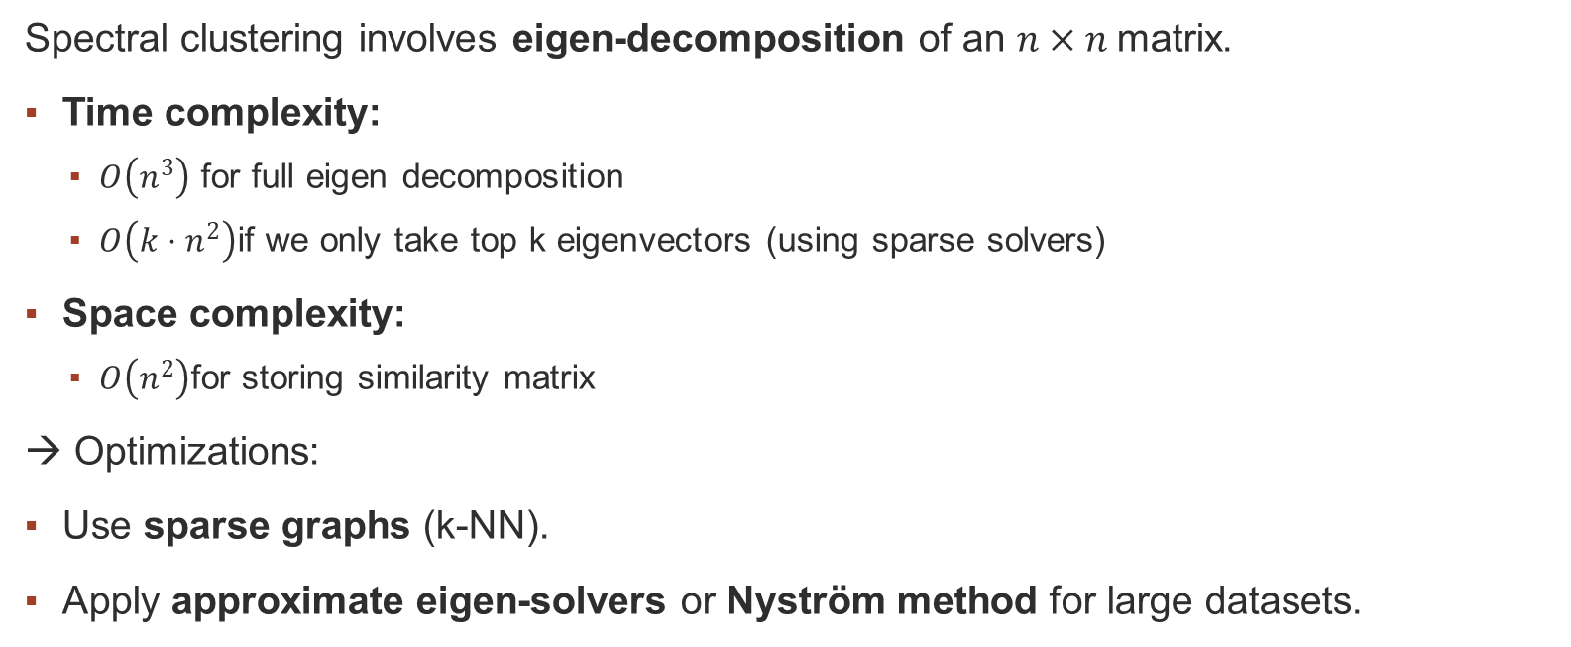
Complexity and Limitations
Spectral clustering involves eigen-decomposition of an $n×n$matrix.
Time complexity:
  $O\left(n^{3}\right)$ for full eigen decomposition
  $O\left(k ⋅ n^{2}\right)$if we only take top k eigenvectors (using sparse solvers)
Space complexity:
  $O\left(n^{2}\right)$for storing similarity matrix
→ Optimizations:
Use sparse graphs (k-NN).
Apply approximate eigen-solvers or Nyström method for large datasets.

